Slide 1
Selective Detection of Histones on RNA Aptamer-Functionalized Gold Surfaces using SPR
Hayley Richardson, Francis Miller, Spyridon Pavlidis
Contact: hrichar2@ncsu.edu, francis.miller@duke.edu, spavlidis@ncsu.edu
August 2020

Slide 2
Contents
Project Objective
Background/Previous experiments
Materials
Aptamer (Ligand) Immobilization
Histone (Analyte) Preparation
Proposed experiments
Appendix
Notes:
What would you need to know?
What is the chip I'm working with?
What is the ligand?
What is the target/analyte?
What buffers and chemicals do I need?
What kinds of tests am I running?
What will my control be?
Consider including some of the SPR results from the Miller/Giangrande paper.
During our call with Brian, we agreed that our first round of tests would mainly focus on confirming specific histone-aptamer binding.
You can frame your design of experiments around answering this question.

Slide 3
Project Objective
Primary objective: to validate the selective binding of RNA aptamers immobilized onto gold surfaces with histones
Secondary objectives:
To determine how the limit of detection (LOD) is impacted by:
Analyte: human histones (H4) vs. calf thymus histones (CTH)
Buffer selection
Buffer dilution
Aptamer to “spacer” molecule ratio on chip surface
To confirm minimal presence of non-specific binding
To use SPR as a control for independent electrical sensing measurements

Slide 4
Background
The presence of histones (11-21 kDa) in the blood is linked to the onset of multiple organ disorder syndrome (MODS).
Urak et al. identified an RNA aptamer (KU7) that can specifically bind to human histone (H4) as a form of treatment (i.e., “deactivate” histones)
Specificity was validated using SPR (results on next slide), but their approach differed from ours:
They used histones as the ligand and aptamers as the analyte. We aim to do the opposite.
They used a high capacity, dextran-based SPR chip (i.e., CDH Biosensor chip). This is not compatible with our electrical sensing method. We are instead aiming to use the SIA Au Kit (bare gold).
K. T. Urak et al., “RNA inhibitors of nuclear proteins responsible for multiple organ dysfunction syndrome,” Nature Communications, vol. 10, no. 1, p. 116, Jan. 2019, doi: 10.1038/s41467-018-08030-y.

Slide 5
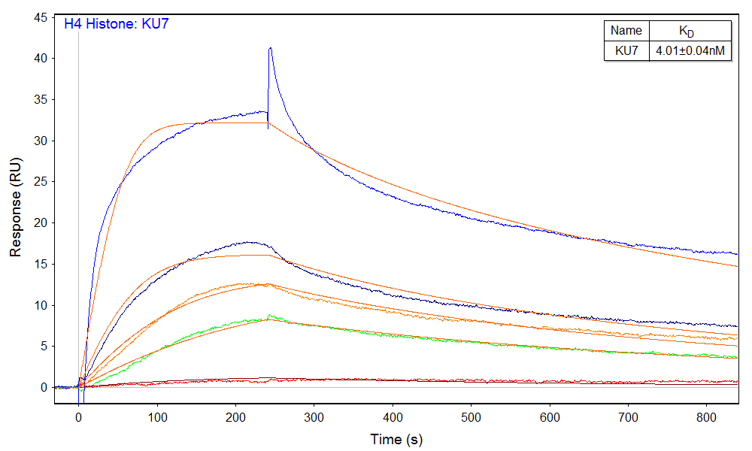
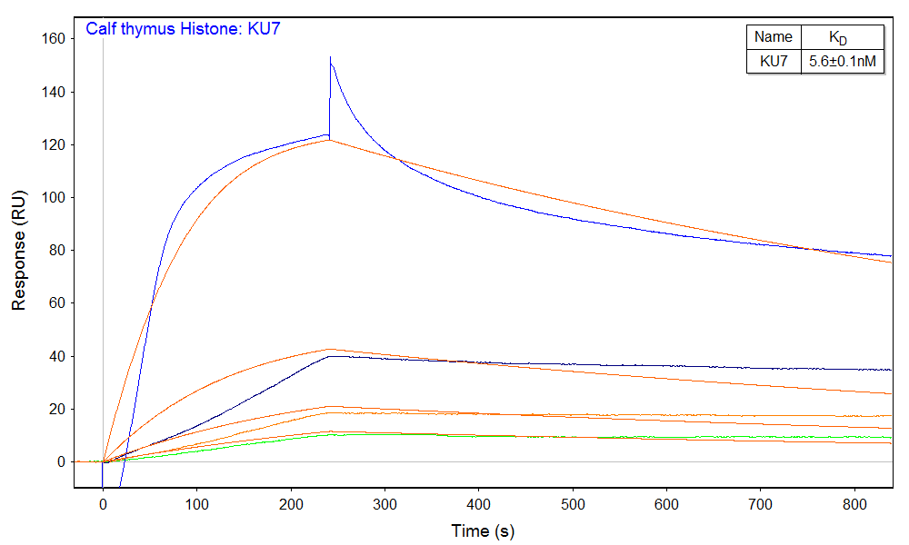
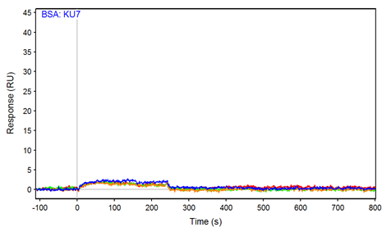
Background – SPR Results
Ligand (CTH and H4) immobilization done by amine coupling on CDH biosensor chip
Negative control: BSA immobilized as ligand
Further notes:
Data were processed by subtracting the reference channel signal and buffer blank responses (double referencing method).
The sensor surface was regenerated after each analyte cycle by injecting 1M NaCl for 1 min.
Biggest response with CTH as ligand
Aptamers concentrations tested: 100nM (blue), 50nM (black), 25nM (red), 12.5nM (green), 10nM (magenta)
Analyte | Ligand | k_{a} (M⁻¹s⁻¹) | k_{d} (s⁻¹) | K_{D}
KU7 | CTH | 1.62±0.03e5 | 9.15±0.06e-4 | 5.6±0.1nM
KU7 | H4 | 5.62±0.05e5 | 2.25±0.01e-3 | 4.01±0.04nM
K. T. Urak et al., “RNA inhibitors of nuclear proteins responsible for multiple organ dysfunction syndrome,” Nature Communications, vol. 10, no. 1, p. 116, Jan. 2019, doi: 10.1038/s41467-018-08030-y.

Slide 6
Materials
Chip: SIA Kit Au (Cytiva). NCSU has already purchased a set (currently have 5 chips)
Ligand: Single strand RNA aptamers (KU7) 20 kDa with thiol termination (IDT).
Chip surface is a mixed monolayer with ligand and 6-mercapto-1-hexanol (MCH)
Analyte: Calf Thymus Histone, 11-21 kDa (Millipore Sigma)
Since the strongest response was seen with CTH previously, we recommend that first experiments are done with it as the analyte
Buffers
RNA suspended in TE buffer (10 mM Tris HCl, 0.1 mM EDTA, pH 7.5) (IDT)
Running buffer – Input needed to select from:
PBS (Cytiva)
HBS variety (Cytiva)
Urak et al used 10 mM HEPES pH 7.4, 150 mM NaCl, and 2 mM CaCl₂
Diluted Buffer
Negative control: BSA
Consistent with Urak paper
Should NCSU purchase?
Notes:
What would you need to know?
What is the chip I'm working with?
What is the ligand?
What is the target/analyte?
What buffers and chemicals do I need?
What kinds of tests am I running?
What will my control be?
Consider including some of the SPR results from the Miller/Giangrande paper.
During our call with Brian, we agreed that our first round of tests would mainly focus on confirming specific histone-aptamer binding.
You can frame your design of experiments around answering this question.

Slide 7
Aptamer (Ligand) Immobilization
To be executed by NCSU prior to SPR chip delivery to Duke
The surface is immobilized with both active ligands (RNA aptamers) & “Spacer” Molecules (MCH)
RNA aptamers are terminated with thiol groups. Immobilization relies on thiol-Au organization to tether RNA to surface.
Spacer molecules (6-mecapto-1-hexanol, MCH) separate aptamers to reduce repulsion and competitive binding.
Procedure:
Immerse the clean surface of the gold in 1 µM aptamer solution for at least 10 hours, 25°C at neutral pH.
Immerse the surface with 1 mM MCH in TE buffer for at least 3 hours.
Briefly wash in TE buffer.
Store at ~ 4°C if not immediately used.
No amine coupling used
P. Fenter, F. Schreiber, L. Berman, G. Scoles, P. Eisenberger and M. J. Bedzyk, Surf. Sci., 1998, 412–13, 213–235
Josephs, E. A., & Ye, T. (2013). Nanoscale spatial distribution of thiolated DNA on model nucleic acid sensor surfaces. Acs Nano, 7(4), 3653-3660.
Aliakbarinodehi, N., Jolly, P., Bhalla, N., Miodek, A., De Micheli, G., Estrela, P., & Carrara, S. (2017). Aptamer-based field-effect biosensor for tenofovir detection. Scientific reports, 7(1), 1-10.
‹#›

Slide 8
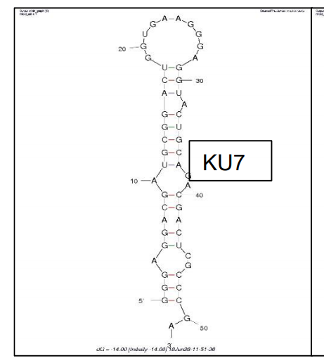
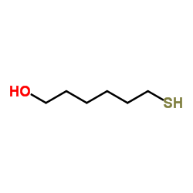
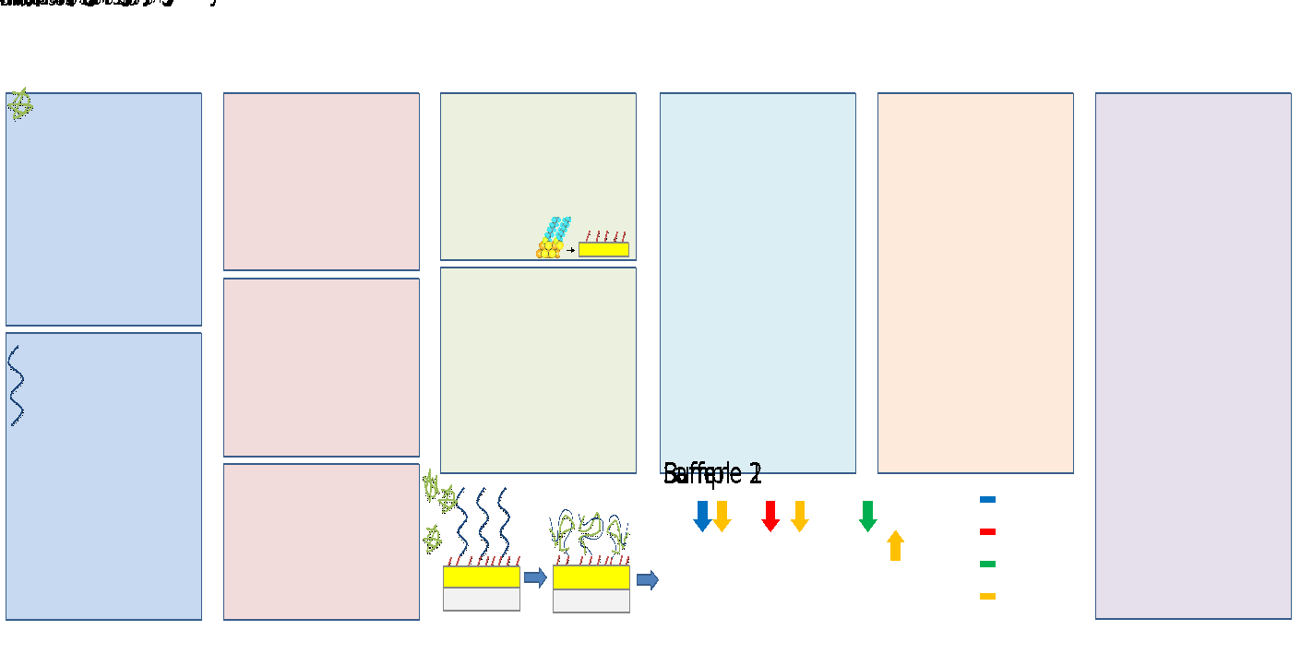
Aptamer (Ligand) Immobilization (cont’d)
Ligand (RNA) is received with thiol group on 5’ terminal end
Thiol groups forms covalent bond with gold
6-mecapto-1-hexanol (MCH) is added to surface after ligand immobilization (also thiol terminated)
MCH forms a similar self-assembled monolayer and separates RNA to reduce repulsion and competitive binding
1 µM RNA solution followed by 1 mM MCH solution.
MCH structure
KU7: RNA aptamer
Histones (green) binding to RNA aptamers (blue). Thiol groups (red) tether molecule to Au or space out ligands.
Y. R. Fernandez et. Al, “Aptamer-functionalized graphene-gold nanocomposites for label-free detection of dielectrophoretic-enriched neuropeptide.” Electrochemistry Communications, vol. 72 Sept. 2016. DOI: 10.1016/j.elecom.2016.09.017
N. Aliakbarinodehi et al., “Aptamer-based Field-Effect Biosensor for Tenofovir Detection,” Scientific Reports, vol. 7, p. 44409, Mar. 2017, doi: 10.1038/srep44409
Notes:
MCH: a spacer between immobilized aptamer molecules for enhancing specificity and optimizing aptamer orientation

Slide 9
Histone (Analyte) Preparation
Raw materials provided by NCSU. Dilutions prepared by Duke.
Testing multiple concentrations can determine kinetic constants for binding.
Create a 1 mM stock solution in buffer (e.g. PBS, HBS, custom HEPES)
Make the desired concentrations to test
Urak: Two-fold dilution series (100nM, 50nM, 25nM, 12.5nM, 10nM)
Should we include higher concentrations? (1 uM, 10 uM, 1mM)
Possibility of saturation limit
“In humans, the normal serum level of histones is very low (< 0.6ng/mL). Serum levels as high as 3ng/mL have been reported in critically ill patients.”
K. T. Urak et al., “RNA inhibitors of nuclear proteins responsible for multiple organ dysfunction syndrome,” Nature Communications, vol. 10, no. 1, p. 116, Jan. 2019, doi: 10.1038/s41467-018-08030-y.
Claudet, C., Angelov, D., Bouvet, P., Dimitrov, S., & Bednar, J. (2005). Histone octamer instability under single molecule experiment conditions. Journal of Biological Chemistry, 280(20), 19958-19965.

Slide 10
Proposed Experiment 1
Objective: Confirm selective binding of CTH to KU7
Parameter | Choice | Comment
Chip | SIA Au
Ligand | KU7
Buffer | Needs discussion | Use Urak’s?
Flow Rate | Needs discussion | Use Urak’s? (4 mins at 30 µL/min)
Analyte | CTH
Analyte Dilutions | Needs discussion | Urak’s: 2-fold series dilution of 100nM to 10nm
Negative Control | BSA
Negative Control Dilutions | Needs discussion | Use same concentration range as analyte?
Regeneration | Needs discussion | Urak used “1M NaCl for 1 min”. Perhaps first try “Kinetic titration” w/o regeneration
Reference Channel: | Separate chip needed*
*Unlike amine coupling experiments, where a reference channel can be made on the same chip, we cannot do this here because the ligand (aptamer) is already immobilized before insert the chip into the SPR
We therefore need to provide you with a separate reference chip that has an MCH-based SAM, but no aptamer

Slide 11
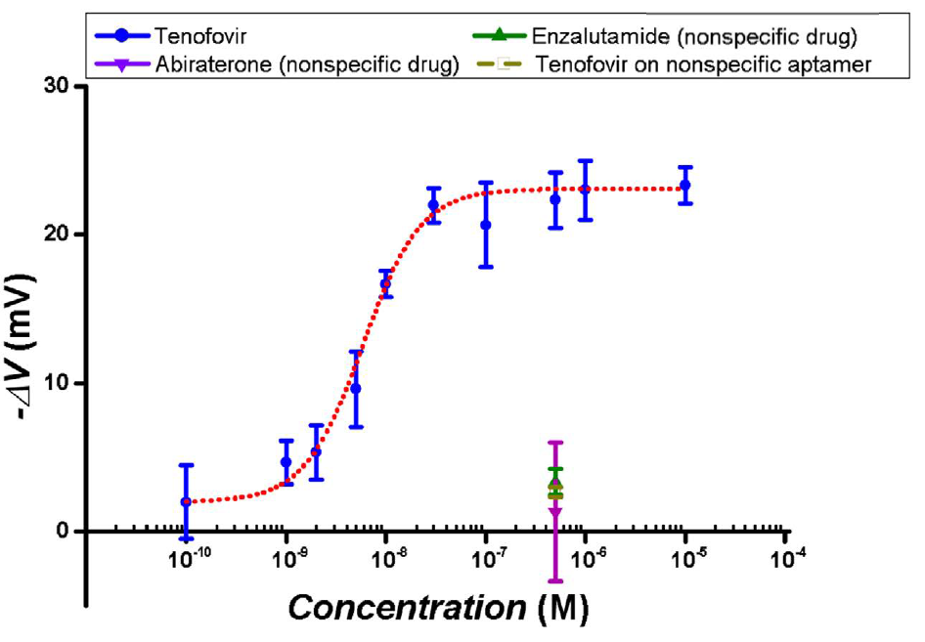
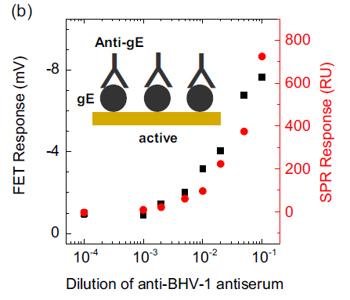
Proposed Experiment 2 - TBD
Objective: Evaluate limit of detection
Motivation: Electrical sensing papers usually have S-curve plots. Can we get something like this from SPR?
Warning: buffer is 10 mM HBS-EP buffer. See Appendix for why.
(left) N. Aliakbarinodehi et al., “Aptamer-based Field-Effect Biosensor for Tenofovir Detection,” Scientific Reports, vol. 7, p. 44409, Mar. 2017, doi: 10.1038/srep44409.
(right) A. Tarasov et al., “A potentiometric biosensor for rapid on-site disease diagnostics,” Biosensors and Bioelectronics, vol. 79, pp. 669–678, 2016, doi: 10.1016/j.bios.2015.12.086.

Slide 12
Proposed Experiment 2 – TBD (cont’d)
Table needs to be updated.
Parameter | Choice | Comment
Chip | SIA Au
Ligand | KU7
Buffer | Needs discussion | Use Urak’s?
Flow Rate | Needs discussion | Use Urak’s? (4 mins at 30 µL/min)
Analyte | CTH
Analyte Dilutions | Needs discussion | Go higher than Urak?
Negative Control | BSA
Negative Control Dilutions | Needs discussion | Use same concentration range as analyte?
Regeneration | Needs discussion | Urak used “1M NaCl for 1 min”. Perhaps first try “Kinetic titration” w/o regeneration
Reference Channel: | Separate chip needed*
*Unlike amine coupling experiments, where a reference channel can be made on the same chip, we cannot do this here because the ligand (aptamer) is already immobilized before insert the chip into the SPR
We therefore need to provide you with a separate reference chip that has an MCH-based SAM, but no aptamer

Slide 13
Proposed Experiment 3 - TBD
Objective: Kinetics evaluation.
Parameter | Choice | Comment
Chip | SIA Au
Ligand | KU7
Buffer | Needs discussion | Use Urak’s?
Flow Rate | Needs discussion | Use Urak’s? (4 mins at 30 µL/min)
Analyte | CTH
Analyte Dilutions | Needs discussion | Go higher than Urak?
Negative Control | BSA
Negative Control Dilutions | Needs discussion | Use same concentration range as analyte?
Regeneration | Needs discussion | Urak used “1M NaCl for 1 min”. Perhaps first try “Kinetic titration” w/o regeneration
Reference Channel: | Separate chip needed*
*Unlike amine coupling experiments, where a reference channel can be made on the same chip, we cannot do this here because the ligand (aptamer) is already immobilized before insert the chip into the SPR
We therefore need to provide you with a separate reference chip that has an MCH-based SAM, but no aptamer

Slide 14
Proposed Experiment 4 - TBD
Objective: Kinetics evaluation.
Parameter | Choice | Comment
Chip | SIA Au
Ligand | KU7
Buffer | Needs discussion | Use Urak’s?
Flow Rate | Needs discussion | Use Urak’s? (4 mins at 30 µL/min)
Analyte | CTH
Analyte Dilutions | Needs discussion | Go higher than Urak?
Negative Control | BSA
Negative Control Dilutions | Needs discussion | Use same concentration range as analyte?
Regeneration | Needs discussion | Urak used “1M NaCl for 1 min”. Perhaps first try “Kinetic titration” w/o regeneration
Reference Channel: | Separate chip needed*
*Unlike amine coupling experiments, where a reference channel can be made on the same chip, we cannot do this here because the ligand (aptamer) is already immobilized before insert the chip into the SPR
We therefore need to provide you with a separate reference chip that has an MCH-based SAM, but no aptamer

Slide 15
Appendix

Slide 16
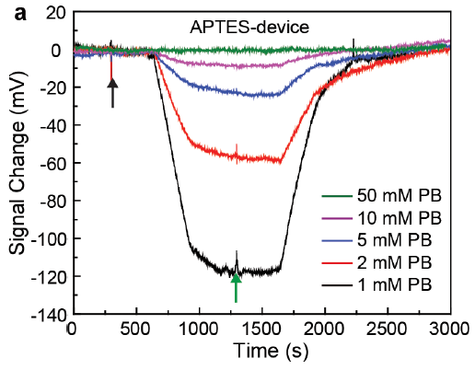
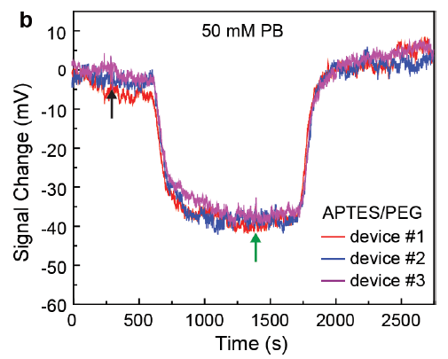
Impact of Phosphate Buffer Ionic Strength
In electronic sensors, the higher the PB ionic strength, the weaker the signal (left graph)
Can be combatted by introducing PEG to the surface (right figure)
We believe SPR is less sensitive so we would like to measure both high and low ionic strength PB solutions in both SPR and electrical sensors for direct comparison
N. Gao, W. Zhou, X. Jiang, G. Hong, T.-M. Fu, and C. M. Lieber, “General Strategy for Biodetection in High Ionic Strength Solutions Using Transistor-Based Nanoelectronic Sensors,” Nano Letters, vol. 15, no. 3, pp. 2143–2148, 2015, doi: 10.1021/acs.nanolett.5b00133.

Slide 17
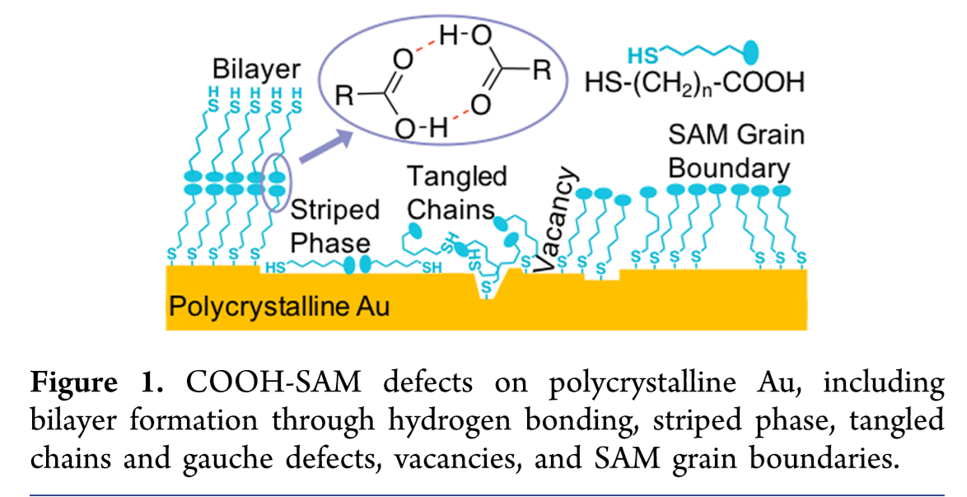
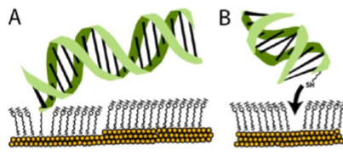
Pre-Blocking
Brightbill (right figure) asserts that the non-specific binding is largely the result of defects
“Preblocking…stabilizes the chip before covalent functionalization while preserving the activity of the sensing surface and the protein receptors”
Josephs (left) found that adding DNA to an existing monolayer yields surfaces that are more uniform, but had too low DNA density for useable sensing.
The order of the surface functionalization steps could be a variable to adjust in later experiments to determine its relationship to monolayer quality and sensing performance.
Nanoscale spatial distribution of thiolated DNA on model nucleic acid sensor surfaces. E. A. Josephs (2013).
Preblocking Procedure to Mitigate Nonselective Protein Adsorption for Carboxyl-SAMs Used in Biosensing. E.Brightbill et. al. (2019)

